Slide 1
Team 2, FICO Training Project
Loan Processing Application
Vinay Prasad
Dinesh Godara
Saurabh Agrawal
Kriti Jain
Lalit Kumar
Pavan Kolla

Slide 2

Agenda
User Interface
Server
Database
Model Development

Slide 3

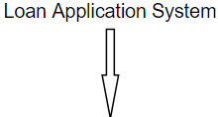
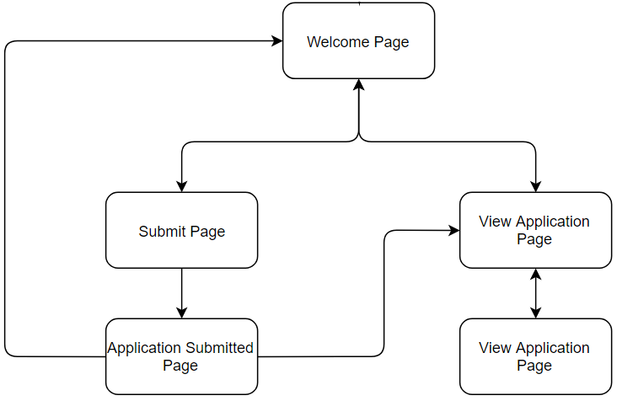
User Interface
Welcome Page
Submit Page
Application Submitted Page
View Applications Page
View Application Details Page

Slide 4
Languages Used
HTML: Basic structure of webpage
CSS: Styling of Webpage
Javascript: Form validations and send/receive data to/from the server

Slide 5
Server
Spring mvc
Controller
RequestMapping

Slide 6
Database
Jdbc
3 tables in db:
Application Details
Application Status
Bureau Data

Slide 7

Model Development
Data Observation
Model Training
Scoring
De-Duplication
Outlier Detection
Variable generation
Logistic Regression
F1 score
Threshold
Scaling

